Slide 1
Chapter 1 Introduction
1.1 Introduction to Object Oriented
1.2 Introduction to UML
1.3 Software Process and OOA&D
1.4 Component and CBSD
1.5 Patterns and Architecture

Slide 2
1.1 Introduction to Object-Oriented
OO Programming (procedural V.S. OO)
Basic concepts of OO

Slide 3
OO Programming

Slide 4




Designing Programs
Software Development – Solving Problem
Place Order
Problem Space
Inventory
Shipping
Descriptions of problem (Human: Requirements)
Business Process
Natural Language
A Gap between languages
Descriptions of solution (Human: Designing Program )
Programming Language
Solution Space
Execution of program
Computer System

Slide 5
Software Development – Solving Problem
Place Order
Problem Space
Inventory
Shipping
Descriptions of problem (Human: Requirements)
Business Process
Natural Language
A Gap between languages
Programming Language
Descriptions of solution (Human: Designing Programs)
High-Level Language (Object-Oriented) e.g. C++ Java
High-Level Language (Procedural) e.g. C, BASIC
Assembly Language
Machine Language
Solution Space
Execution of program
Computer System

Slide 6
Procedural Programming
This programming paradigm is essentially an abstraction of machine /assembly language.
Program is organized around procedures.
Focus on data structures, algorithms and sequencing of steps
Programs = Algorithm + Data Structure
An algorithm is a set of instructions for solving a problem
A data structure is a construct used to organize data in a specific way.
Most computer languages, from early examples like FORTRAN and ALGOL to more recent languages like C and Ada, have been imperative or procedural.

Slide 7
Procedural Programming - Example
Writing a program to handle bank accounts
  Customer can open different type of accounts, such as cash account, check account and Loan account.
  For each account, customer can deposit, withdraw or transfer.
How to write this program with C ?

Slide 8
Procedural Programming - Example
Programs = Algorithm + Data Structure
Struct account {
char name;
int accountId;
float balance;
float interestYTD;
char accountType;
};
Procedure 1: Deposit() {...}
Data Structure:
Bank Account
Procedure 1: Withdraw() {...}
Procedure 1: Transfer() {...}
A procedural programming language usually consists of :
  A collection of variables, each of which at any stage contains a certain value (a number, a character, a string of characters, etc)
  A collection of statements that change the values of these variables.
The building-block of this type program is the procedure or function.

Slide 9
Procedural Programming - Disadvantages
Procedures and data are clearly separated.
Transformation of concepts between analysis & implementation.
Design models are a long step from implementation.
Procedures are often hard to reuse.
Programs are often hard to extend and maintain.
Data
a gap
Procedure
Analysis
a gap
Design
NJ
NY
NJ
NY
Hudson river
Hudson river

Slide 10
Object-Oriented Programming: OOP
A design and programming technique
Some terminology:
  object - usually a person, place or thing (a noun)
  method - an action performed by an object (a verb)
  type or class - a category of similar objects (such as automobiles)
Objects have both data and methods
Objects of the same class have the same data elements and methods
Objects send and receive messages to invoke actions

Slide 11
Object-Oriented Programming - Example
Writing a program to handle bank accounts
  Customer can open different type of accounts, such as cash account, check account and Loan account.
  For each account, customer can deposit, withdraw or transfer.
How to write this program with C++ or Java ?

Slide 12
Object-Oriented Programming - Example
Object-Oriented approach
  combine the accounts (data) with the operations on the accounts to objects.
  A new kind of data type: BankAccount class
C++ code:
Class BankAccount {
private:
float balance;
float interestYTD;char * owner;
int account_number;
public:
void Deposit (float amount) {...}
float WithDraw (float amount) {…}
bool Transfer (BankAccount & to, float amount) {…}
};

Slide 13
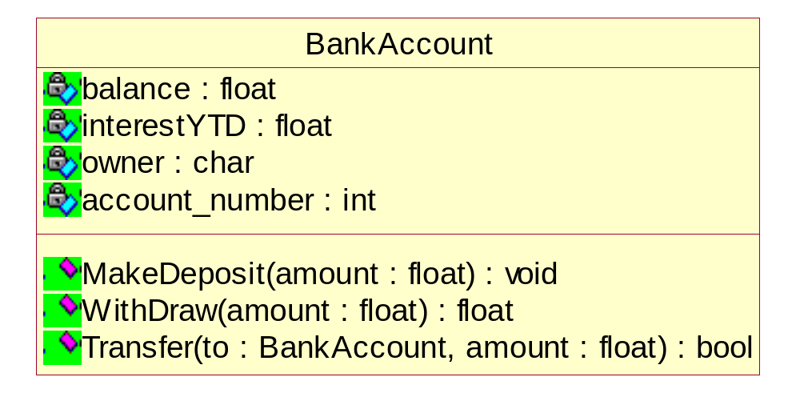
Object-Oriented Programming - Example
The building-block of this type program is class or objects.

Slide 14
Example - The Shape Application
We have an application that must be able to draw circles and squares on a standard GUI
The circles and squares must be drawn in a particular order.
A list of the circles and squares will be created in the appropriate order, and the program must walk the list in that order and draw each circle or square.

Slide 15
Example - Procedural Programming in C
Data Structure
---Shape.h --------------------------------------------
Enum Shape {circle, square};
struct Shape {
ShapeType itsType;
};
---Circle.h --------------------------------------------
struct Circle {
Shape itsType;
double itsRadius;
Point itsCenter;
};
---square.h -------------------------------------------
struct Square {
Shape itsType;
double itsSide;
Point itsTopLeft;
};

Slide 16
Example - Procedural Programming in C
Function
---drawAllShapes.c --------------------------------------------
typedef struct Shape *ShapePointer;
Void DrawAllShapes (ShapePointer list[], int n) {
int I;
for (i=0; i<n; i++) {
struct Shape* s = list[i];
switch (s->itsType) {
case square:
DrawSquare((struct Square*)s);
break;
case circle:
DrawCircle((struct Circle*)s);
break;
}
}
}

Slide 17
Example - Procedural Programming in C
Problems
  Rigid: because the addition of Triangle causes Shape,Square,Circle, and DrawAllShapes to be recompiled and redeployed.
  Fragile: because there will be many other switch/case or if/else statements that are both hard to find and hard to decipher.
  Immobile: because anyone attempting to reuse DrawAllShapes in another program is required to bring along Square and Circle, even if that new program does not need them.

Slide 18
Example – Object-Oriented Programming in C++
class Shape {
public:
virtural void Draw() const= 0;
};
class Square : public Shape {
public:
virtual void Draw() const;
};
class Circle : public Shape {
public:
virtual void Draw() const;
};
void DrawAllShapes(vector <Shape*>& list) {
vector<Shape*> :: iterator I;
for (i = list.begin(); i != list.end(); i++)
(*i)->Draw();
}
It is changed by adding new code rather than by changing existing code.
Not rigid
Not Fragile
Not Immobile

Slide 19
Example - Object-Oriented Programming in C++
Now, the requirement is changed:
All Circles should be drawn before any Squares
In previous solution, The DrawAllSquares function is not closed against this change.
How can we close the DrawAllShapes function against changes in the ordering of drawing?
  Using Abstraction.
  Using a “Data-Driven” Approach
  …..

Slide 20
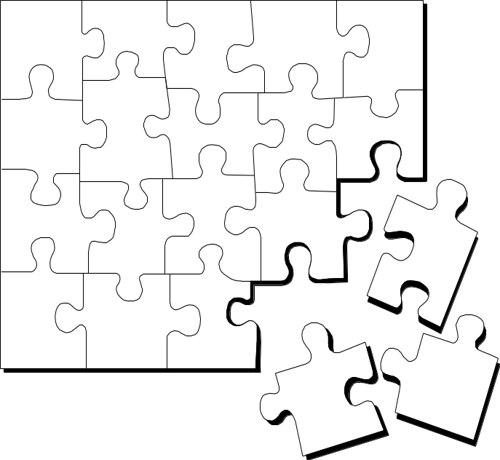
What Is Object Technology?
Object Technology
  A set of principles guiding software construction together with languages, databases, and other tools that support those principles.
  (Object Technology - A Manager’s Guide, Taylor, 1997)
Notes:
Object technology is not simply the use of an object-oriented language like Java or C++. It is based on the principles of abstraction, modularity, hierarchy, and encapsulation. (These will be defined in Module 3.)
If an organization is to successfully implement object technology, they must use more than a language. They must also use process, a modeling language (UML), data modeling techniques, and so on.

Slide 21
The History of Object Technology
Major object technology milestones
Simula
C ++
The UML
1967
Late 1980s
1996
1972
1991
2000+
Smalltalk
Java
???
Notes:
Object technology is not a new idea. It has been around for over 30
years. Below is a brief history of the major milestones in the history of object technology.
In 1967, Simula was designed and became the first language to use objects and classes.
In 1972, Alan Kay and others at Xerox PARC created Smalltalk whose roots were tied to Simula. In 1980 Smalltalk became the first commercial release of an object-oriented programming environment.
Bjarne Stroustrop, the originator of the C++ language, released C++ to the public in the late 1980’s. C++ was not an entirely new language, but an extension of C abilities.
In 1991, James Gosling, created a language named Oak that was the predecessor to Java. It was created because his development team at Sun Microsystems was writing software for information appliances. He found that C++ was too complex and insecure for the job. Therefore, he created the Oak language.
We’ve included this slide to show students that object technology is not new. It has been around for a long time and is a proven and fairly mature technology.

Slide 22
Strengths of Object Technology
A single paradigm
  A single language used by users, analysts, designers, and implementers
Facilitates architectural and code reuse
Models more closely reflect the real world
  More accurately describes corporate entities
  Decomposed based on natural partitioning
  Easier to understand and maintain
Stability
  A small change in requirements does not mean massive changes in the system under development
Adaptive to change
Notes:
An object-oriented model aims at reflecting the world we experience in reality. Thus, the objects themselves often correspond to phenomena in the real world that the system is to handle. For example, an object can be an invoice in a business system or an employee in a payroll system.
Object technology can help a company change its systems almost as fast as the company itself changes.

Slide 23
Basic concepts of OO

Slide 24
Basic Concepts of Object Orientation
Object
Class
Message
Basic Principles of Object Orientation
Abstraction
Encapsulation
Inheritance
Polymorphism
Interface and Abstract Class

Slide 25

What Is an Object?
Informally, an object represents an entity, either physical, conceptual, or software.
  Physical entity
  Conceptual entity
  Software entity
Truck
Chemical Process
Linked List
Notes:
Objects allow the software developer to represent real-world concepts in their software design. These real-world concepts can represent a physical entity such as a person, truck, or space shuttle.
Objects can be concepts like a chemical process or algorithms.
Object can even represent software entities like a linked list.

Slide 26
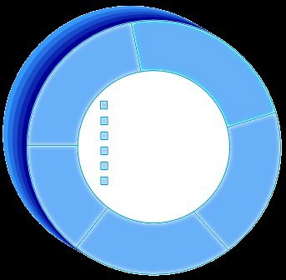
A More Formal Definition
An object is an entity with a well-defined boundary and identity that encapsulates state and behavior.
  State is represented by attributes and relationships.
  Behavior is represented by operations, methods, and state machines.
Attributes
Object
Operations
Notes:
An object is an entity that has a well-defined boundary. That is, the purpose of the object should be clear.
An object has two key components: attributes and operations.
Attributes represent an object’s state, and operations represent the behavior of the object.
Object behavior and state are discussed in the next few slides.
Take a moment to explain the graphic on this slide.
Attributes are documented on the inside of the doughnut.
Operations are documented on the borders, which will become clear to the student as we discuss topics like encapsulation.
Note that the doughnut is not part of the UML notation. UML notation will be discussed later.

Slide 27
An Object Has State
The state of an object is one of the possible conditions in which an object may exist.
The state of an object normally changes over time.
Name: J Clark
Employee ID: 567138
HireDate: 07/25/1991
Status: Tenured
Discipline: Finance
MaxLoad: 3
Professor Clark
Name: J Clark
Employee ID: 567138
Date Hired: July 25, 1991
Status: Tenured
Discipline: Finance
Maximum Course Load: 3 classes
Professor Clark
Notes:
The state of an object is one of the possible conditions that an object may exist in, and it normally changes over time.
The state of an object is usually implemented by a set of properties called attributes, along with the values of the properties and the links the object may have with other objects.
State is not defined by a “state” attribute or set of attributes. Instead, state is defined by the total of an object’s attributes and links. For example, if Professor Clark’s status changed from Tenured to Retired, the state of the Professor Clark object will change.
Provide some supplemental state exercises to ensure that the class understands the concept of state.

Slide 28
An Object Has Behavior
Behavior determines how an object acts and reacts.
The visible behavior of an object is modeled by the set of messages it can respond to (operations the object can perform).
SubmitFinalGrades()
AcceptCourseOffering()
Professor Clark
Professor Clark’s behavior
  Submit Final Grades
  Accept Course Offering
  Take Sabbatical
Maximum Course Load: 3 classes
SetMaxLoad()
TakeSabbatical()
Professor Clark
Notes:
The second characteristic of an object is that it has behavior. Objects are intended to mirror the concepts that they are modeled after, including behavior.
Behavior determines how an object acts and reacts to requests from other objects.
Object behavior is represented by the operations that the object can perform. For example, Professor Clark can choose to take a sabbatical once every five years. The Professor Clark object represents this behavior through the TakeSabbatical() operation.

Slide 29


An Object Has Identity
Each object has a unique identity, even if the state is identical to that of another object.
Professor “J Clark” teaches Biology
Professor “J Clark” teaches Biology
Notes:
In the real world, two people can share the same characteristics: name, birth date, job description. Yet, there is no doubt that they are two individuals with a unique identity.
The same concept holds true for objects. Although two objects may share the same state (attributes and relationships), they are separate, independent objects with their own unique identity.

Slide 30
Objects Need to Collaborate
Objects are useless unless they can collaborate together to solve a problem.
  Each object is responsible for its own behavior and status.
  No one object can carry out every responsibility on its own.
How do objects interact with each other?
  They interact through messages.
Notes:
At this stage, we’ve discovered a number of different classes and defined these classes. However, our work has just begun. These objects need to realize the behavior specified in each use-case scenario. How is this done? The objects must collaborate together to bring about the desired behavior in the system.
Is there a mechanism that will allow these objects to work together? There is, and that mechanism is called a message.
We are working our way toward CRC cards. The goal of this slide is to make students aware that collaborations are a key part of a successful OO solution.

Slide 31
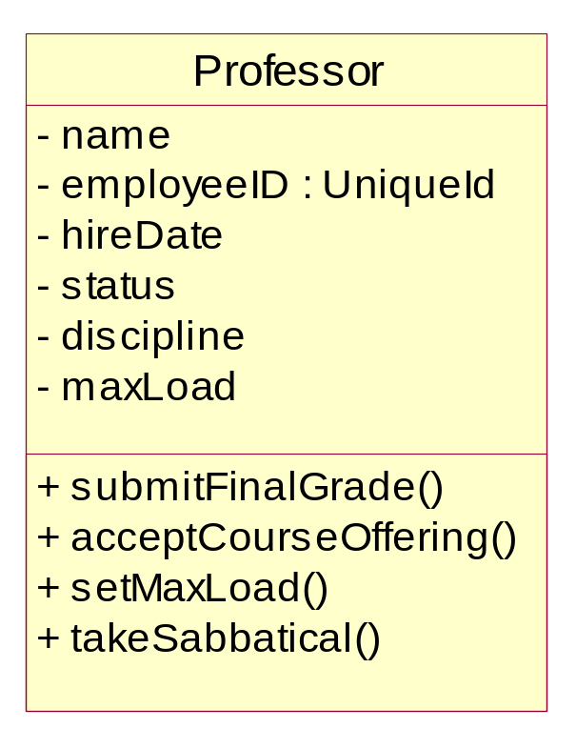
What Is a Class?
A class is a description of a set of objects that share the same properties and behavior.
  An object is an instance of a class.
Class: Professor
Objects
Attributes
Professor Smith
Professor Mellon
Professor Jones
Operations
Notes:
A Class can be defined as:
A description of a set of objects that share the same attributes, operations, relationships, and semantics. (The Unified Modeling Language User Guide, Booch, 1999)
There are many objects identified for any domain.
Recognizing the commonalties among the objects and defining classes helps us deal with the potential complexity.
The OO principle abstraction helps us deal with complexity.

Slide 32
A Sample Class
Class: Automobile
Data Items:
  manufacturer’s name
  model name
  year made
  color
  number of doors
  size of engine
  etc.
Methods:
  Define data items (specify manufacturer’s name, model, year, etc.)
  Change a data item (color, engine, etc.)
  Display data items
  Calculate cost
  etc.

Slide 33
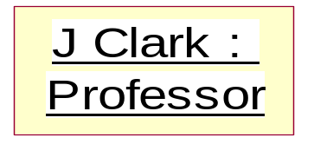
The Relationship Between Classes and Objects
A class is an abstract definition of an object.
  It defines the structure and behavior of each object in the class.
  It serves as a template for creating objects
Objects are grouped into classes.
An object is an instance of a class.
From Real World
Class: Professor
Professor Jones
Professor Smith
abstracting
Objects
Professor Mellon
instancing
Objects
To computer World
Notes:
A class is a description of a set of objects that share the same responsibilities, relationships, operations, attributes, and semantics.
An object is defined by a class. A class defines a template for the structure and behavior of all its objects. The objects created from a class are also called the instances of the class.
The class is the static description, and the object is a run-time instance of that class.
We model from real-world objects. Software objects are based on the real-world objects, but exist only in the context of the system.
We use real-world objects, abstract out what you don't care about. Then, take these abstractions and go through the process of classification based on what you do care about. Classes in the model are the result of this classification process.
These classes are then used as templates within an executing software system to create software objects. These software objects represent the real-world objects we originally started with.
Some classes/objects may be defined that don't represent real-world objects. They are there to support the design and are "software only.”
A class is to an object what a cookie cutter is to a cookie.

Slide 34
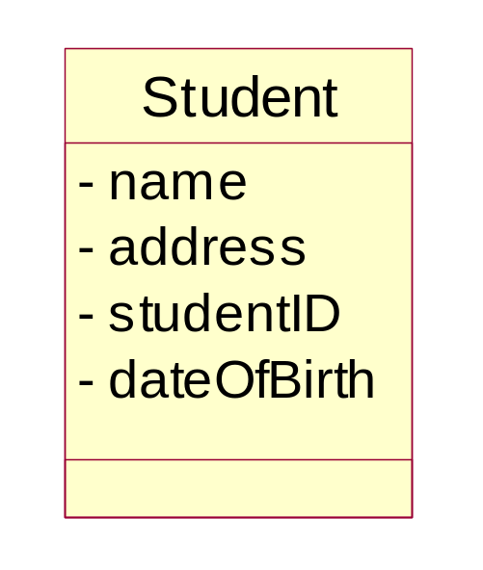
What Is an Attribute?
An attribute is a named property of a class that describes a range of values instances of the property may hold.
  A class may have any number of attributes or no attributes at all.
Attributes
Notes:
An attribute can be defined as:
A named property of a class that describes the range of values that instances of the property may hold. (The Unified Modeling Language User Guide, Booch, 1999)
A class may have any number of attributes or no attributes at all. At any time, an object of a class will have specific values for every one of its class’s attributes.
An attribute defined by a class represents a named property of the class or its objects. An attribute has a type that defines the type of its instances.
An attribute has a type, which tells us what kind of attribute it is. Typical attributes are integer, Boolean, real, and enumeration. These are called primitive types. Primitive types can be specific for a certain programming language.
Remember, there are still operations in this class, but we chose to suppress them.

Slide 35
Attributes in Classes and Objects
Class
name: M. Modano
address: 123 Main
studentID: 9
dateofBirth: 03/10/1967
Objects
name: D. Hatcher
address: 456 Oak
studentID: 2
dateofBirth: 12/11/1969
Notes:
At the class level, the Student class attributes indicate that the Students have names, addresses, studentID’s, and a date of birth.
At the object level, the attributes indicate the values for the name, address, studentID, and date of birth.
Only the class instance (objects) should be able to change the value of the attributes.
The state of an object is defined by the value of its attributes and the existence of links to other objects.
Remember, the doughnuts are not UML icons. They are included in this illustration to show that the attribute values are set in the individual object.
Object diagrams do not permit you to view the attribute values.

Slide 36
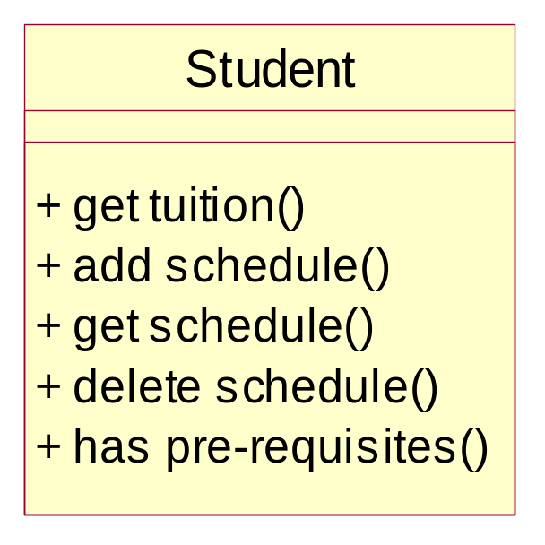
What Is an Operation?
An operation is the implementation of a service that can be requested from any object of the class to affect behavior.
A class may have any number of operations or none at all.
Operations
Notes:
An operation can be defined as:
The implementation of a service that can be requested from any object of the class to affect behavior. (The Unified Modeling Language User Guide, Booch, 1999)
The operations in a class describe what the class can do.
An operation can either be a command or a question. A question should never change the state of the object. Only a command can change the state of the object.
An operation is described with a return-type, name, and zero or more parameters. Together, the return-type, name, and parameters are called the signature of the operation.
The outcome of the operation depends on the current state of the object. Often, but not always, invoking an operation on an object changes the object’s data or state.
Point out that these should be called operations. Many people will use the term methods instead of operations.
In the UML, methods and operations are not synonymous and have distinct definitions.

Slide 37
Example: class Professor
class Professor {
private String name;
private int age;
private String speciality;
public Professor (String sm, int ia, String ss) {
name = sm;
age = ia;
speciality = sst;
}
public String getName () { return name;}
public int getAge () { return age;}
public String getSpeciality () {
return speciality;}
}
Professor
- name : String
- age : int
- speciality : String
+getName() : String
+getAge() : int
+getSpeciality() : String

Slide 38
Example : Instance of Professor
wang : Professor
name = “wang”
age = 35
speciality = “computer”
Professor wang = new Professor (“wang”, 35, “computer”);

Slide 39
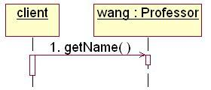

What is a message?
A specification of a communication between objects that conveys information with the expectation that activity will ensue
  One object asks another object to perform an operation.
What is your name?
Professor wang
wang.getName()

Slide 40
Example: Object Interaction
The OrderEntryForm wants Order to calculate the total dollar value for the order.
calculateOrderTotal()
CalculateOrderTotal()
orderID
date
salesTotal
tax
shipDate
Message
OrderEntryForm
Order
The class Order has the responsibility to calculate the total dollar value.
Notes:
This example demonstrates how objects interact to achieve the desired business functionality. The example is from an order-entry system where the order-entry clerk enters all sales information on the OrderEntryForm, stereotyped as a boundary class.
After all information has been entered into the form, the system must calculate the total dollar value for the sale. Calculating the total dollar value for the sale involves knowledge of the list price of the items in the sale, tax, and any discounts that may apply.
It does not make sense for the OrderEntryForm to calculate the total dollar amount because it does not own the attribute that stores this value. The object that owns this attribute is the Order object. Therefore, the Order object has an operation, calculateOrderTotal, that knows how to calculate the sales total. Also, in keeping with the principle of encapsulation, no other object should be allowed to change the value of sales total.
The OrderEntryForm knows that the sales total needs to be calculated. Therefore, it sends a message to Order to carry out this behavior. The Order object will calculate the total and send a return value back to the OrderEntryForm where the total can be displayed.
Point out how messages support the principle of encapsulation.
As a rule of thumb, if an attribute is owned by an object, that object needs to know how to calculate the values for that attribute. No other object should be able to do so.
Remember, class responsibilities are realized by its operations and attributes.

Slide 41
Basic Principles of Object Orientation
Object Orientation
Abstraction
Encapsulation
Inheritance
Polymorphism
Notes:
There are four basic principles of object orientation. They are:
Abstraction
Encapsulation
Inheritance
Polymorphism
Be sure the students understand objects before you begin this next section.
We’ve introduced objects first to help students better apply each of these principles.

Slide 42

What Is Abstraction?
Abstraction can be defined as:
  Any model that includes the most important, essential, or distinguishing aspects of something while suppressing or ignoring less important, immaterial, or diversionary details. The result of removing distinctions so as to emphasize commonalties.
  (Dictionary of Object Technology, Firesmith, Eykholt, 1995)
Abstraction
  Emphasizes relevant characteristics.
  Suppresses other characteristics.
BriefCase
- Capacity
- Weight
+ open()
+ close()
Notes:
Abstraction can be defined as:
Any model that includes the most important, essential, or distinguishing aspects of something while suppressing or ignoring less important, immaterial, or diversionary details. The result of removing distinctions so as to emphasize commonalties. (Dictionary of Object Technology, Firesmith, Eykholt, 1995)
Abstraction allows us to manage complexity by concentrating on the essential characteristics of an entity that distinguish it from all other kind of entities.
An abstraction is domain and perspective dependent. That is, what is important in one context, may not be in another.
OO allows us to model our system using abstractions from the problem domain (for example, classes and objects).
A car is an example of an abstraction. A car is an abstraction for “a mobile, powered vehicle for transporting people from place to place.”
The abstract use of car is not concrete. However, if you describe the car as a 1995 Blue Ford Mustang, then it becomes a concrete manifestation and not an abstraction.
Discuss the makings of a good abstraction.
Concise
Single coherent concept, and so on

Slide 43

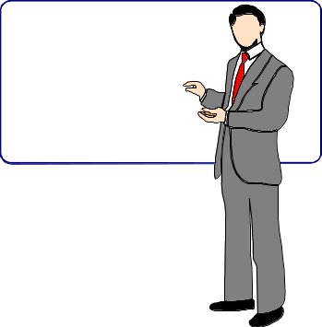
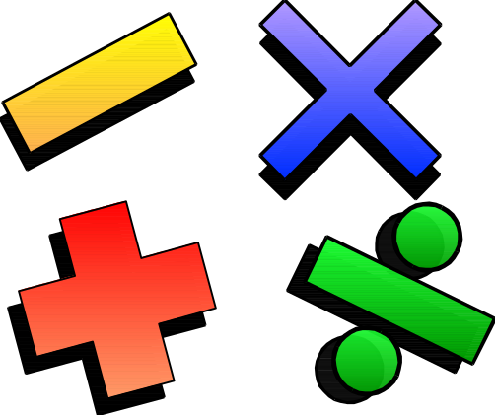

Example: Abstraction
Student
Professor
Course Offering (9:00 AM,
Monday-Wednesday-Friday)
Course (e.g. Algebra)
Notes:
The following are examples of abstraction.
A student is a person enrolled in classes in the university.
A professor is a person teaching classes at the university.
A course is a class offered by the university.
A course offering is a specific offering for a course, including days of the week and times.

Slide 44
What Is Encapsulation?
Encapsulation means to design, produce, and describe software so that it can be easily used without knowing the details of how it works.
Also known as information hiding
An analogy:
When you drive a car, you don’t have know the details of how many cylinders the engine has or how the gasoline and air are mixed and ignited.
Instead you only have to know how to use the controls.

Slide 45
What Is Encapsulation?
Hide implementation from clients
  clients depend on interface
Improves Resiliency
Notes:
Encapsulation can be defined as:
The physical localization of features (e.g., properties, behaviors) into a single blackbox abstraction that hides their implementation (and associated design decisions) behind a public interface. (Dictionary of Object Technology, Firesmith, Eykholt, 1995)
Encapsulation is often referred to as “information hiding,” making it possible for the clients to operate without knowing how the implementation implements the interface.
Encapsulation eliminates direct dependencies on the implementation (clients depend on/use the interface). Thus, it’s possible to change the implementation without updating the clients as long as the interface is unchanged.
Clients will not be affected by changes in implementation, thus reducing the “ripple effect,” where a correction to one operation forces the corresponding correction in a client operation and so on. As a result of encapsulation, maintenance is easier and less expensive.
Encapsulation offers two kinds of protection. It protects an object’s internal state from being corrupted by its clients and client code from changes in the object’s implementation.
Encapsulation is putting the “data bits” and operations that manipulate them in the same place.
Encapsulation does NOT allow direct manipulation of things that have been encapsulated without using the supplied interface.
An example is a car’s accelerator. Generally speaking, you put your foot down and the car goes faster. You don’t worry about the cables, electronics, engine, and the rest.

Slide 46
Encapsulation Illustrated
Professor Clark needs to be able to teach four classes in the next semester.
Professor Clark
SubmitFinalGrades()
AcceptCourseOffering()
Name: J Clark
Employee ID: 567138
HireDate: 07/25/1991
Status: Tenured
Discipline: Finance
MaxLoad:4
SetMaxLoad(4)
SetMaxLoad()
TakeSabbatical()
Notes:
The key to encapsulation is an object’s message interface. The object interface ensures that all communication with the object takes place through a set of predefined operations. Data inside the object is only accessible by the object’s operations. No other object can reach inside of the object and change its attribute values.
For example, Professor Clark needs to have her maximum course load increased from three classes to four classes per semester. Another object will make a request to Professor Clark to set the maximum course load to four. The attribute, MaxLoad, is then changed by the SetMaxLoad() operation.
Encapsulation is beneficial in this example because the requesting object does not need to know how to change the maximum course load. In the future, the number or variables that are used to define the maximum course load may be increased, but doesn’t not affect the requesting object. It depends on the operation interface for the Professor Clark object.
Note that encapsulation can also be illustrated using interfaces. However, the scope of this course does not include this discussion.
Point out that the requesting object does not need to know the structure of the Professor object to request a state change.
The object that owns the attributes is the only one allowed to change its own attributes.

Slide 47
Encapsulation – Information/Implementation hiding
Information which can’t be accessed by client
Balance
insterestYTD
Owner
Account_number
Deposit() {…}
Withdraw() {…}
Transfer() {…}
Interface
Client
Deposit()
Withdraw()
Transfer()
Implementation details which are invisible for client.

Slide 48
What Is Inheritance ?
Inheritance —a way of organizing classes
Term comes from inheritance of traits like eye color, hair color, and so on.
Classes with properties in common can be grouped so that their common properties are only defined once.
Is an “is a kind of” relationship

Slide 49
An Inheritance Hierarchy
Vehicle
Automobile
Motorcycle
Bus
Sedan
Sports Car
School Bus
Luxury Bus
What properties does each vehicle inherit from the types of vehicles above it in the diagram?

Slide 50
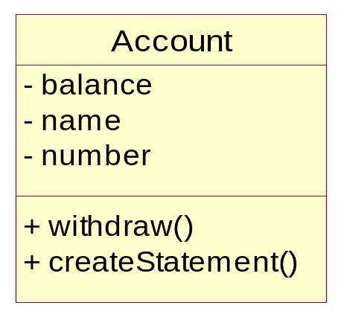
Example: Single Inheritance
One class inherits from another.
Ancestor
Superclass (parent)
Inheritance Relationship
Savings
Checking
Subclasses
Descendents
Notes:
The generalization is drawn from the subclass class to the superclass/parent class.
The terms “ancestor” and “descendent” may be used instead of “superclass” and “subclass.”

Slide 51
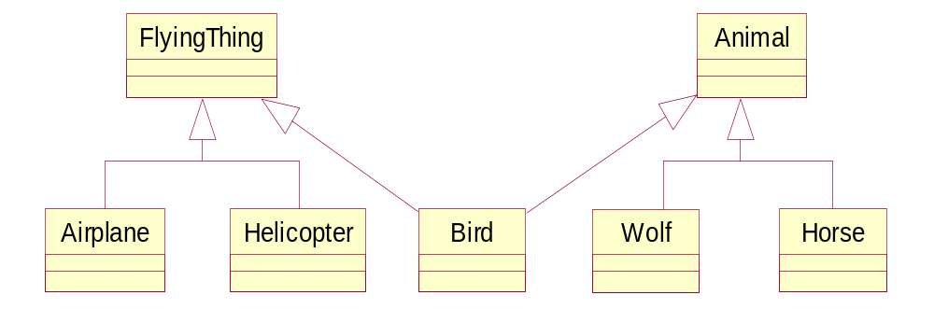
Example: Multiple Inheritance
A class can inherit from several other classes.
Multiple Inheritance
Use multiple inheritance only when needed and
always with caution!
Notes:
Multiple inheritance means that a class can inherit from several other classes. For example, Bird inherits from both FlyingThing and Animal.
Multiple inheritance is conceptually straight forward and may be needed to model the real world accurately. However, there are potential implementation problems when you use multiple inheritance, and not all implementation languages support it. Thus, be judicious with your use of multiple inheritance. Use it only where it accurately describes the concept you are trying to model and reduces the complexity of your model. Be aware, however, that this representation will probably need to be adjusted in design and implementation.
Generally, a class inherits from only one class.
Some languages do not support multiple inheritance.

Slide 52
Polymorphism
Polymorphism—the same word or phrase can be mean different things in different contexts
Analogy: in English, bank can mean side of a river or a place to put money
In Java, two or more classes could each have a method called output
Each output method would do the right thing for the class that it was in.
One output might display a number whereas a different one might display a name.

Slide 53
What Is Polymorphism?
The ability to hide many different implementation behind a single interface.
Manufacturer B
Manufacturer A
Manufacturer C
OO Principle:
Encapsulation
Notes:
The Greek term polymorphos means “having many forms.” Every implementation of the interface must implement at the very least the interface. In some cases, the implementation can implement more than the interface.
For example, the same remote can be used to control any type of television that supports a specific interface (the interface the remote was designed to be used with).

Slide 54
Example: Polymorphism
Get Current Value
getCurrentValue()
getCurrentValue()
getCurrentValue()
Stock
Bond
Mutual Fund
Notes:
In this example, a requesting object would like to know the current value of a financial instrument. However, the current value for each financial instrument is calculated in a different fashion. The stock needs to determine the current asking price in the financial market that it is listed under. The bond needs to determine the time to maturity and interest rates. A mutual fund needs to look up the closing price from the day from the fund management company.
In a non object-oriented development environment, we would write code that may look something like this:
IF financialInstrument = Stock THEN
calcStockValue()
IF financialInstrument = Bond THEN
calcBondValue()
IF financialInstrument = MutualFund THEN
calcMutualFundValue()
With object technology, each financial instrument can be represented by a class, and each class would know how to calculate its own value. The requesting object simply needs to ask the specific object (for example, Stock) to get its current value. The requesting object does not need to keep track of three different operation signatures. It only needs to know one. Polymorphism allows the same message to be handled in different ways depending on the object that receives it.
This diagram shows how three different object can have the same operation: getCurrentValue().
However, the way that each interprets that operation is unique because the current value for each instrument is dependent on different variables.
Point out that the requesting object does not need to know anything about the calculations or the differences. All it cares is that the current value is calculated.

Slide 55

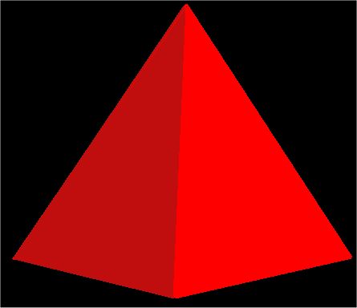
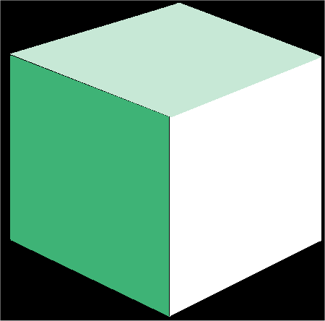
What is an Interface?
An interface is a collection of operations that specify a service of a class or component.
Interfaces formalize polymorphism
Interfaces support “plug-and-play” architectures
‘How’
Tube
<<Interface>>
Shape
‘What’
Pyramid
draw()
move()
scale()
rotate()
Cube
Realization relationship
(stay tuned for realization relationships)
Notes:
Interfaces are not abstract classes, as abstract classes allow you to provide default behavior for some/all of their methods. Interfaces provide no default behavior.
From the UML User’s Guide (Booch, 1999): An interface is “a collection of operations that are used to specify a service of a class or a component.”
Interfaces formalize polymorphism. They allow us to define polymorphism in a declarative way, unrelated to implementation. Two elements are polymorphic with respect to a set of behaviors if they realize the same interfaces. In other words, if two objects use the same behaviors to get different, but similar results, they are considered to be polymorphic. A cube and a pyramid can both be drawn, moved, scaled, and rotated, but they look very different.
You’ve probably heard that polymorphism one of the big benefits of object orientation, but without interfaces there was no way to enforce it, verify it, or even express it except in informal or language-specific ways. Formalization of interfaces strips away the mystery of polymorphism and gives us a good way to describe, in precise terms, what polymorphism is all about. Interfaces are testable, verifiable, and precise.
Interfaces are the key to the “plug-and-play” ability of an architecture: Any classifiers (e.g., classes, subsystems, components) which realize the same interfaces may be substituted for one another in the system, thereby supporting the changing of implementations without affecting clients.
Realization relationships are discussed later in this module.

Slide 56
How Do You Represent An Interface?
Elided/Iconic Representation
(“lollipop”)
Tube
Pyramid
Shape
Cube
Canonical (Class/Stereotype) Representation
Tube
<<Interface>>
Shape
Pyramid
draw()
move()
scale()
rotate()
Cube
(stay tuned for realization relationships)
Notes:
The lollipop notation is best used when you only need to denote the existence of an interface. If you need to see the details of the interface (e.g., the operations), then the class/stereotype representation is more appropriate.
From The Random House Collegiate Dictionary:
Elide: “to pass over; omit; ignore.”
Canonical: “authorized; recognized; accepted.”
According to the “UML User Guide” there are two ways to represent a realizes relationship with an interface. The Elided form (“Lollipop”) is useful when you want to expose the seams of the system, however, there is a limitation in that you can’t visualize the operations on the interface.
The second way, canonical, allows you to visualize the operations on the interface.

Slide 57
What is an Abstract Class?
An abstract class is a class that may not has any direct instances.
In the UML, you specify that a class is abstract by writing its name in italics.
An abstract operation is an operation that it is incomplete and requires a child to supply an implementation of the operation.
In the UML, you specify an abstract operation by writing its name in italics.
Shape
{abstract}
Abstract class
draw () {abstract}
Abstract operation
Circle
Rectangle
draw ()
draw ()
Notes:
In the Best Practices module, we discussed some characteristics common to successful projects. OO facilitates the following best practices:
Develop Iteratively
Model Visually
Use Component Architecture
Defining basic OO terms and concepts allows everyone in the class to start on a level playing field.

Slide 58
1.2 Introduction to UML
What is modeling?
What is visual modeling ?
What is the UML?

Slide 59
What is modeling?

Slide 60
What is modeling?
A model is a simplification of reality.
What is this Thing?
Modeling a Briefcase
BriefCase
Abstracting
- Capacity
- Weight
+ open()
+ close()
Notes:
In the Best Practices module, we discussed some characteristics common to successful projects. OO facilitates the following best practices:
Develop Iteratively
Model Visually
Use Component Architecture
Defining basic OO terms and concepts allows everyone in the class to start on a level playing field.

Slide 61
What is modeling?
A model is an abstraction of things.
Emphasizes relevant characteristics.
  Suppresses other characteristics.
What is this Thing?
A new Use for a Briefcase
Abstracting
BriefCase
- Capacity
- Weight
+ open()
+ close()
+ sitOnIt()
Questions:
Why did we model the thing as “Briefcase”?
Why did we not model it as a “chair”?
What do we do if the sitOnIt() operation is the most frequently used operation?
The briefcase is only used for sitting on it. It is never opened nor closed.
Is it a “Chair”or a “Briefcase”?
Notes:
In the Best Practices module, we discussed some characteristics common to successful projects. OO facilitates the following best practices:
Develop Iteratively
Model Visually
Use Component Architecture
Defining basic OO terms and concepts allows everyone in the class to start on a level playing field.

Slide 62


The Importance of Modeling
Less Important
More Important
Paper Airplane
F-16 Fighter Jet
Notes:
You can take a piece of paper and a paper clip, and, in a few minutes, have a paper airplane that will entertain your kids. If it isn’t built just right, you can always start over and build another airplane.
Would it be smart for you to build an F-15 fighter jet in the same way? That is, start with some steel, nuts, bolts, and wiring and go right to work. Of course not. You’re building an airplane that costs millions of dollars, and the cost of failure is high. You’re also be part of a much larger team, needing blueprints and models to effectively communicate with one another. (The Unified Modeling Language User Guide, Booch, 1999)
It’s inconceivable that a defense contractor would build an fighter as complex as the F-15 without modeling the airplane first. Why? Because unlike building paper airplanes, the cost of failure is significant.
As a general rule, modeling becomes more important as the complexity and expense rises.

Slide 63
Why Do We Model?
We build models to better understand the system we are developing.
Modeling achieves four aims. Modeling
  Helps us to visualize a system as we want it to be.
  Permits us to specify the structure or behavior of a system.
  Gives us a template that guides us in constructing a system.
  Documents the decisions we have made.
We build models of complex systems because we cannot comprehend such a system in its entirety.
Notes:
According to Booch in The Unified Modeling Language Use Guide, modeling achieves four aims:
Models help us to visualize a system as we want it to be. A model helps the software team communicate the vision for the system being developed. It is very difficult for a software team to have a unified vision of a system that is only described in specification and requirement documents. Models bring about understanding of the system.
Models permit us to specify the structure of behavior of a system. A model allows us to document system behavior and structure before coding the system.
Models give us a template that guides us in constructing a system. A model is an invaluable tool during construction. It serves as a road map for a developer. Have you experienced a situation where a developer coded incorrect behavior because he/she was confused over the wording in a requirements document? Modeling helps alleviate that situation.
Models document the decisions we’ve made. Models are valuable tools long term because they give “hard” information on design decisions. We don’t need to rely on someone’s memory.
To clarify, we are discussing formal modeling, not modeling written on a white writing or on a back of a napkin at lunch.

Slide 64
What is visual modeling?

Slide 65
What Is Visual Modeling?
Place Order
“Modeling captures essential
parts of the system.”
Dr. James Rumbaugh
Inventory
Shipping
Business Process
Visual Modeling is modeling
using standard graphical notations
Computer System
Notes:
In the world today, we have business processes and computer systems. As software professionals, our challenge lies in mapping the two.
That is where modeling comes into play. Modeling involves capturing the important real world “things” and mapping these “things” to computer systems.
To do this, we need a method to show this mapping. This method is visual modeling. Modeling creates a blueprint for the system we want to build, using a standard language that is understood by all. This language is the UML discussed later in this module.
Let’s now look at five main benefits of visual modeling.

Slide 66
Visual Modeling Captures Business Processes
Use-case analysis is a technique to capture business processes from a user’s perspective.
Notes:
Most applications are made up of many business processes. Use-case analysis allows us to capture these business processes from a user point of view . In addition, use-case analysis allows us to create clear pathways through the business processes. Since everyone is using the same language, you mitigate the risk that the customer says one thing and the analyst changes the message in the translation to software “talk.”
Note that use-case analysis is NOT new. In the early 80s, many U.S. government projects mandated that a document called an Operations Concept be created. This document listed who was going to use the system, what their roles and responsibilities were, and what they wanted the system to do. The document was written from a user point of view. This document contained USE CASES.
Use-case analysis allows the analyst to understand WHAT is to be built before trying to build the system.

Slide 67
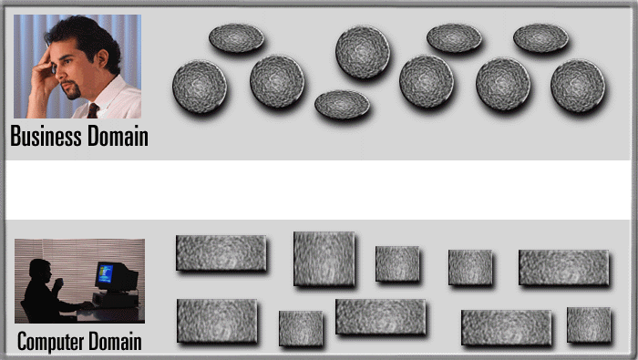
Visual Modeling Is a Communication Tool
Use visual modeling to capture business objects and logic.
Use visual modeling to analyze and design your application.
Notes:
Business analysts and domain experts define requirements. Software architects and developers build systems based on requirements. Typically, they have communication problems due to different use of terminology and different definition of concepts. This is where visual modeling makes a difference.
Visual modeling is used to capture the business world. It is also used to capture and document the computer world. And most importantly, visual modeling provides a smooth transition between the two different worlds with traceability from the business world to the computer world.
Remind students that this course concentrates on system modeling, not business modeling.

Slide 68
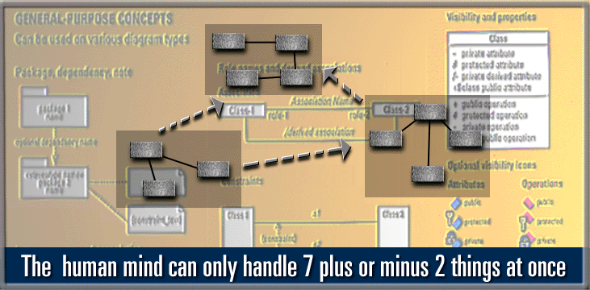
Visual Modeling Manages Complexity
Notes:
Here is a model of the business we showed previously. A sale is comprised of a salesperson who calls on a customer, who orders a product, which is shipped by a vehicle.
The customer may be an individual or a corporation. The vehicle may be a truck or a train. This is, of course, a very small model.
In the real world, systems contain hundreds and even thousands of classes. Having one picture with 3000 classes pasted to a wall in a conference room is not very useful. We need a way to group these classes into meaningful collections.
Visual modeling has the concept of a package, which is a group of things. By using packages, you can group modeling elements into meaningful collections, providing the capability to show the model at different levels of abstraction to different groups of people. For example, customers typically work at a high level, while developers need to dig deep into the model.

Slide 69
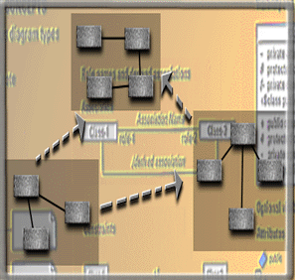
Visual Modeling and Software Architecture
User Interface
(Visual Basic,
Java)
Business Logic
(C++, Java)
Model your system
independent of
implementation language
Database Server
(C++ & SQL)
Notes:
The following is a personal story to illustrate visual modeling. Modify for your own instruction.
When I was a child I had a tree house in the backyard. We built it by using wood found in Tommy’s garage and nails that my Dad gave to us. We had no idea what it would look like when we were building I. We just hammered the wood together until we ran out of nails. There is no way I would enter that tree house today.
When I was putting an addition on my house, I spent weeks just looking at the blueprints making sure that everything was right before the addition was built. When contractors build buildings today, they typically have many different views of the building—the floor plans, the plumbing, the electrical system to name of few.
We also need this for software we build today. We are building more and more complex systems every day. And the days of “just hacking out the code” are gone!
There are typically different views of the software architecture. One view is the Logical View ( the what) and the other view is the Physical View (the how). The Logical View is mapped to the Physical View. For example, the user interface is built in VB and/or Java and runs on a specific location. The business logic is written in C++ and runs somewhere else. Database information is written in C++ and SQL and runs on yet another machine or server.
By modeling the logical architecture independent of the physical architecture, you will build a system that is resilient to change. If a new language is developed, the business logic may be mapped to the new language with a minimum of change. This method of analysis mitigates the “ripple down” effect of change. That is, one little change causes a big software change.

Slide 70
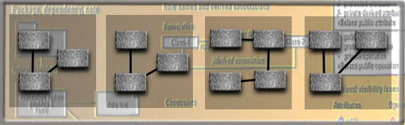
Visual Modeling Promotes Reuse
Multiple Systems
Reusable
Components
Notes:
Reuse is the holy grail of software. There are many forms of reuse—reusing a class, reusing a group of classes or a component, and applying a pattern. No matter the form of reuse used, you reuse more than the code. You reuse all the analysis, design, implementation, test, and documentation that was needed to build the original artifact.
Visual modeling allows you to see what is available from a reuse point of view to determine if, indeed, the artifact may be reused.

Slide 71
What is the UML?

Slide 72

What Is the UML?
UML is an acronym for Unified Modeling Language
The UML is a language for
  Visualizing
  Specifying
  Constructing
  Documenting
the artifacts of a software-intensive system.
UML: Object-Oriented & Visual Modeling
Notes:
The software systems we develop today are more complex than the human mind can comprehend. This is why we model systems. The choice of the models to create has a profound influence on how we attack the problem and shape the solution.
No single model is sufficient. Every complex system is best approached through a small set of nearly independent models.
Therefore, to increase comprehension, a common language like the Unified Modeling Language (UML) is used to express models.
A modeling language is a language whose vocabulary and rules focus on the conceptual and physical representation of a system. A modeling language like the UML is a standard language for software blueprints.

Slide 73
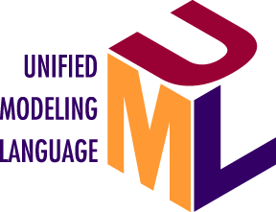
History of the UML
Planned major revision (2001)
UML 2.0
Planned minor revision (2000)
UML 1.4
Current minor revision 1999
UML 1.3
Public
Feedback
OMG Acceptance, Nov 1997
Final submission to OMG, Sept 1997
First submission to OMG, Jan 1997
UML 1.1
UML partners
UML 1.0
Web - June 1996
OOPSLA 95
Notes:
This information is merely to give students the perspective that the UML was developed, taking the best of several methodologies and that it isn’t owned by Rational.
Depending on your audience, you can briefly highlight this slide and move on.
Let’s take a brief look at the history of the UML. In the late 80s and early 90s there were many different methodologies. Three of the more popular methods were the Booch method by Grady Booch, the OMT method by Jim Rumbaugh, and the OOSE method by Ivar Jacobson.
Each method had its strengths and weaknesses. Booch was great in design. OMT and OOSE were great in analysis. Around 1991, all three methodologies were explained in books. Then a funny thing happened. In 1993, Grady published his 2nd edition book, which contained a lot of the good analysis techniques from OMT and OOSE along with his great design stuff. Jim published a series of articles usually referred to as “OMT-2” which contained his great analysis techniques along with use cases from OOSE and design information from Booch. Thus, the unofficial unification had begun. In October 1994, Jim joined Rational (he is a Rational Fellow) and Grady and Jim worked on an official unification. At OOPSLA in 1995, the .8 version of the Unified Method was published. It was at this time that Objectory joined the Rational family. Ivar was then included in the unification process and the three amigos were born. The 3 amigos spent until June 1996 maturing the Unified Method. In June, the .9 version was published. Here, the name officially changed to UML since it is a language NOT a process. The UML was again released to the public and feedback was collected. It was also during this time that feedback was incorporated from our UML partners—companies like Microsoft, Oracle, IBM to name a few. In January 1997, the 1.0 version was released. Final feedback was collected and incorporated into the UML 1.1 version. This version was accepted as the standard by the OMG on November 14, 1997.

Slide 74
OMG UML Specification
UML Semantics
UML Notation Guide
UML Example Profiles
UML Model Interchange
Object Constraint Language Specification
UML Standard Elements
Glossary

Slide 75
UML Semantics
Four-Layer Metamodel Architecture:
Layer
Description
Example
The infrastructure for a etamodeling architecture. Defines the language for specifying metamodels.
MetaClass,
MetaAttribute,
MetaOperation
meta-metamodel
An instance of a meta-metamodel.
Defines the language for specifying a
model.
Class, Attribute, Operation,
Component
metamodel
An instance of a metamodel. Defines a language to describe an information domain.
StockShare, askPrice,
sellLimitOrder,
StockQuoteServer
model
An instance of a model. Defines a specific information domain.
<Acme_SW_Share_98789>,654.56, sell_limit_order,
<Stock_Quote_Svr_3223>
user objects
(user data)

Slide 76
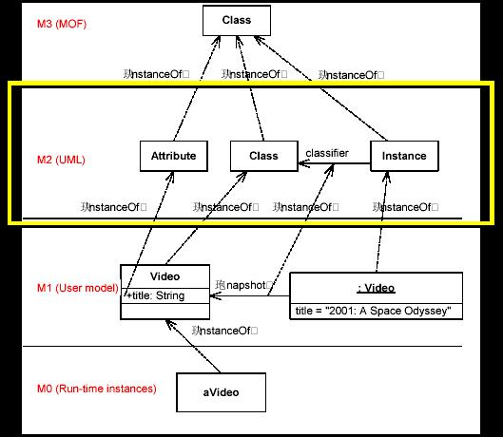
3.1.1 UML Semantics

Slide 77
UML Semantics
Behavioral Elements
Model
Management
Collaborations
Use Cases
Activity Graphs
Common Behavior
State Machines
Foundation
Core
Extension
Mechanisms
Data Types

Slide 78
1.3 Software Process and OOA&D
Iterative Development and the Unified Process
Object-Oriented Analysis and Design Overview

Slide 79
Iterative Development and
the Unified Process

Slide 80
A Definition of Process
A process defines Who is doing What, When and How to reach a certain goal.
New or changed
requirements
Software Engineering
Process
New or changed
system
Notes:
It can be very difficult to explain what a process is, if people aren’t already familiar with it. An informal example most people can relate to is the process of balancing a checkbook at the end of the month. Most of us have developed a process we use -- the same steps every month. It shortens the time required to accomplish the task and ensures that we don’t forget any steps. The same applies to a software engineering process. We want it to be repeatable and ensure that all required tasks are accomplished when required. Of course, a software engineering process is much more complex than balancing a checkbook, and there is a tremendous amount of information contained in the RUP.

Slide 81
Agile Process
An agile process implies a light and adaptive process, nimble in response to changing needs
Example: XP (eXtreme Programming)
heavy vs. light
  A heavy process is a pejorative term meant to suggest one with the following qualities:
    many artifacts created in a bureaucratic atmosphere
    rigidity and control
    elaborate, long-term, detailed planning
    predictive rather than adaptive

Slide 82
Agile Process
predictive vs. adaptive
  A predictive process is one that attempts to plan and predict the activities and resource (people) allocations in detail over a relatively long time span, such as the majority of a project.
  Predictive processes usually have a “waterfall” or sequential lifecycle—first, defining all the requirements; second, defining a detailed design; and third, implementing.
  In contrast, an adaptive process is one that accepts change as an inevitable driver and encourages flexible adaptation; they usually have an iterative lifecycle.

Slide 83
Waterfall Development Characteristics
Delays confirmation of critical risk resolution
Measures progress by assessing work-products that are poor predictors of time-to-completion
Delays and aggregates integration and testing
Precludes early deployment
Frequently results in major unplanned iterations
Waterfall Process
Requirements
analysis
Design
Code and unit test
Subsystem integration
System test
Notes:
Waterfall is conceptually straightforward because it produces a single deliverable. The fundamental problem of this approach is that it pushes risk forward in time, where it’s costly to undo mistakes from earlier phases. An initial design will likely be flawed with respect to its key requirements, and furthermore, the late discovery of design defects tends to result in costly overruns and/or project cancellation. The waterfall approach tends to mask the real risks to a project until it is too late to do anything meaningful about them.
To illustrate a problem with the waterfall model: Suppose you estimate that the project will take 2 years, and it really takes 3 years. At the end of 2 years, what do I have? Nothing useful works. No partial delivery is possible. Diagrams and models are great, but they can’t execute.

Slide 84

Iterative Development Produces an Executable
Requirements
Analysis & Design
Planning
Implementation
Initial
Planning
Management
Environment
Test
Evaluation
Each iteration results in an executable release
Deployment
Notes:
The earliest iterations address greatest risks. Each iteration produces an executable release. Each iteration includes integration and test.
Resolves major risks before making large investments
Enables early user feedback
Makes testing and integration continuous
Focuses project short-term objective milestones
Makes possible deployment of partial implementations
Iterative processes were developed in response to these waterfall characteristics. With an iterative process, the waterfall steps are applied iteratively. Instead of developing the whole system in lock step, an increment (that is, a subset of system functionality) is selected and developed, then another increment, etc. The selection of the first increment to be developed is based on risk, the highest priority risks first. To address the selected risk(s), choose a subset of use cases. Develop the minimal set of use cases that will allow objective verification (i.e., through a set of executable tests) of the risks that you have chosen. Then select the next increment to address the next highest risk, and so on. Thus you apply the waterfall within each iteration and the system evolves incrementally.

Slide 85
Risk Profiles
Waterfall Risk
Iterative Risk
Risk
Risk Reduction
Time
Notes:
Iterative development produces the architecture first, allowing integration to occur “as the verification activity” of the design phase and design flaws to be detected and resolved earlier in the lifecycle. Continuous integration throughout the project replaces the big bang integration at the end of a project. Iterative development also provides much better insight into quality, because system characteristics that are largely inherent in the architecture (e.g., performance, fault tolerance, maintainability) are tangible earlier in the process. Thus issues are still correctable without jeopardizing target costs and schedules.

Slide 86
Introduction to UP(Unified Process)
Best Practices
Key concepts
UP structure
Core Workflow
Appling UML in the UP
The RUP is a Process Framework

Slide 87
Best Practices
Develop Iteratively
Manage Requirements
Use Component Architectures
Model Visually
Verify Quality
Control Changes

Slide 88




Key concepts
Worker, Artifact and Activity
A role played by an individual or a team
Activity
A unit of work
Worker
How does
it?
Who does it?
Analyst
Describe a
Use Case
responsible for
Artifact
What is produced?
Use case
A piece of information that is produced, modified, or used by a process
Use case
package

Slide 89
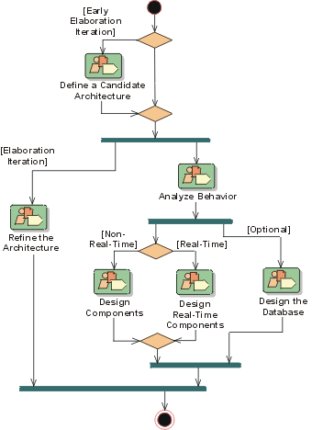
Key concepts
Workflow (Discipline)
  A workflow is a sequence of activities that produces a result of observable value
When does
it?

Slide 90
UP Structure
UP Structure
Lifecycle Phases
Major Milestones
Phases and Iterations
Iterations and Workflow

Slide 91

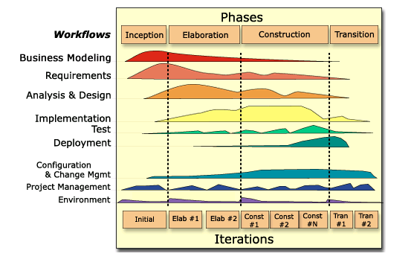

UP Structure
In an iteration, you walk through all workflows
Workflows group activities logically
Notes:
This graphic illustrates how phases and iterations (the time dimension) relate to the development activities (the workflow dimension). The relative size of the color area indicates how much of the activity is performed in each phase/iteration.
Each iteration involves activities from all workflows. The relative amount of work related to the workflows changes between iterations. For instance, during late Construction, the main work is related to Implementation and Test and very little work on Requirements is done.
Note that requirements are not necessarily complete by the end of Elaboration. It is acceptable to delay the analysis and design of well-understood portions of the system until Construction because they are low in risk.
Can iterations overlap?
No. Our model is to show no overlap among iterations. In a large project, several teams may work in parallel on their portions of the iteration, but we do not consider these to be separate iterations.
How many iterations should you have?
It depends on many factors. Err on the side of too many iterations.
Animation note: The callouts and black rectangle appear 2 seconds after the slide.

Slide 92
Process Structure - Lifecycle Phases
Inception
Elaboration
Construction
Transition
time
The Unified Process has four phases:
  Inception - Define the scope of project
  Elaboration - Plan project, specify features, baseline architecture
  Construction - Build the product
  Transition - Transition the product into end user community
Notes:
During Inception, we define the scope of the project, what is included, and what is not. We do this by identifying all the actors and use cases, and by drafting the most essential use cases (usually approximately 20% of the complete model). A business plan is developed to determine whether resources should be committed to the project.
During Elaboration, we focus on two things: get a good grasp of the requirements (80% complete), and establish an architectural baseline. If we have a good grasp of the requirements and the architecture, we can eliminate a lot of the risks and will have a good idea what amount of work remains to be done. We can make detailed cost/resource estimations at the end of Elaboration.
During Construction, we build the product in several iterations up to a beta release.
During Transition, we transition the product to the end user and focus on end user training, installation, and support.
The amount of time spent in each phase varies. For a very complex project with a lot of technical unknowns and unclear requirements, Elaboration may include 3-5 iterations. For a very simple project, where requirements are known and the architecture is simple, Elaboration may include only a single iteration.
The student notes are quite extensive. There is no need to go into that much detail in class. The important thing is to understand how the RUP uses phases to organize the lifecycle.
You can also mention that we deliberately chose names that do not match the waterfall names (analysis, design, implementation, and test) to emphasize that they are NOT the same as the waterfall phases.
Some ways of describing the phases in common terminology:
Inception -- bid and proposal
Elaboration -- building blueprints
Construction -- I think I’m done
Transition -- how do users react?

Slide 93
Phase Boundaries Mark Major Milestones
Inception
Elaboration
Construction
Transition
time
Lifecycle
Objective
Milestone
Lifecycle
Architecture
Milestone
Initial Operational
Capability
Milestone
Product
Release
Notes:
At each of the major milestones, we review the project and decide whether to proceed with the project as planned, to abort the project, or to revise it. The criteria used to make this decision vary by phase.
The evaluation criteria for the inception phase (LCO) include: stakeholder concurrence on scope definition and cost/schedule estimates; requirements understanding as evidenced by the fidelity of the primary use cases; credibility of cost/schedule estimates, priorities, risks, and development process; depth and breadth of any architectural prototype; actual expenditures versus planned expenditures.
The evaluation criteria for the elaboration phase (LCA) include: stability of the product vision and architecture; resolution of major risk elements; adequate planning and reasonable estimates for project completion; stakeholder acceptance of the product vision and project plan; acceptable expenditure level.
The evaluation criteria for the construction phase (IOC) include: stability and maturity of the product release (i.e., is it ready to be deployed?); readiness of the stakeholders for the transition; acceptable expenditure level.
At the end of the transition phase, we decide whether to release the product. We base this primarily on the level of user satisfaction achieved during the transition phase. Often this milestone coincides with the initiation of another development cycle to improve or enhance the product. In many cases, this new development cycle may already be underway.
The student notes are extensive, and there is no need to go into detail with each milestone. The most important point to get across is that there are formal milestones marking major decision points with the RUP lifecycle just like there is in the waterfall.
The criteria listed in the student notes are extensive because they are thorough. However, only one or two of the criteria at each point are really important. The ones to emphasize are:
LCO: scope agreed upon and risks understood and reasonable
LCA: high risks addressed and architecture stable
IOC: product is complete and quality acceptable

Slide 94
Iterations and Phases
Inception
Elaboration
Construction
Transition
Preliminary
Iteration
Architect.
Iteration
Architect.
Iteration
Devel.
Iteration
Devel.
Iteration
Devel.
Iteration
Transition
Iteration
Transition
Iteration
Minor Milestones: Releases
An iteration is a distinct sequence of activities based on an established plan and evaluation criteria, resulting in an executable release (internal or external).
Notes:
Within each phase, there is a series of iterations. The number of iterations per phase will vary. Each iteration results in an executable release encompassing larger and larger subsets of the final application.
An internal release is kept within the development environment and (optionally) demonstrated to the stakeholder community. We provide stakeholders (usually users) with an external release for installation in their environment. External releases are much more expensive (they require user documentation and technical support) and normally occur only during the transition phase.
The end of an iteration marks a minor milestone. At this point, we assess technical results and revise future plans as necessary.

Slide 95
Core Workflow
Core Process Workflows
1) Business Modeling
2) Requirements
3) Analysis & Design
4) Implementation
5) Test
6) Deployment
Core Supporting Workflows
7) Configuration & Change Management
8) Project Management
9) Environment

Slide 96
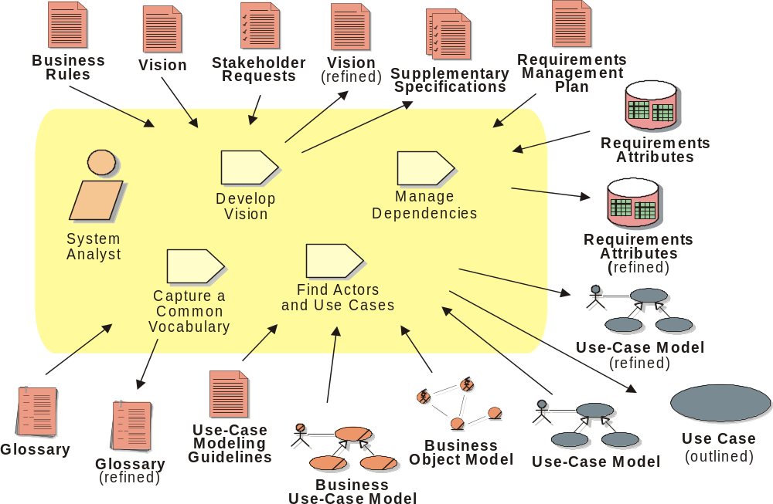
Workflow Detail: Requirements - Define the System
Notes:
An artifact is a work product of the process: roles use artifacts to perform activities, and produce artifacts in the course of performing activities. Artifacts are the responsibility of a single role, to promote the idea that every piece of information in the process must be the responsibility of a specific person. Even though one person may "own" the artifact, many other people may use the artifact, perhaps even updating it if they have been given permission.
The workflow detail diagram shows a set of activities that often are done “together.” It also shows input and output artifacts (indicated with arrows), as well as the roles involved.

Slide 97
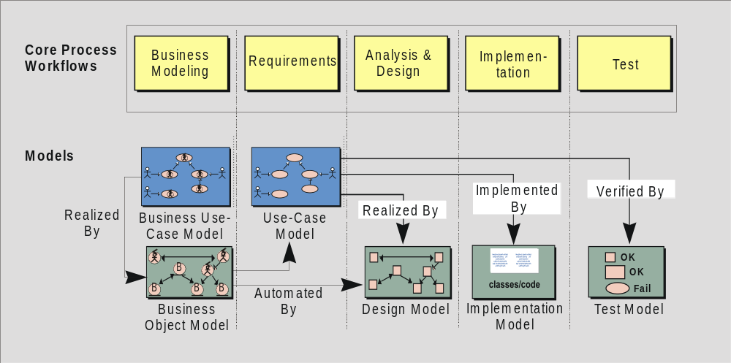
Appling UML in the UP
Notes:
The Rational Unified Process is a model-driven approach. Several models are needed to fully describe the evolving system. Each major workflow produces one of those models. The models are developed incrementally across iterations.
The Business Model is a model of what the business processes are and the business environment. It can be used to generate requirements on supporting information systems.
The Use-Case Model is a model of what the system is supposed to do and the system environment.
The Design Model is an object model describing the realization of use cases. It serves as an abstraction of the implementation model and its source code.
The Implementation Model is a collection of components, and the implementation subsystems that contain them.
The Test Model encompasses all of the test cases and procedures required to test the system.
You can relate this back to previous slides that describe the system model and the many diagrams needed to fully communicate its content. One can consider all of the models listed here, taken together, to be “the system model.”
The only model that is a little different is the business model. It describes the business at large, not just the automated part. The other models describe the information system that supports the business model.
It is a good idea to point out that each of these models is incrementally developed across many iterations.

Slide 98
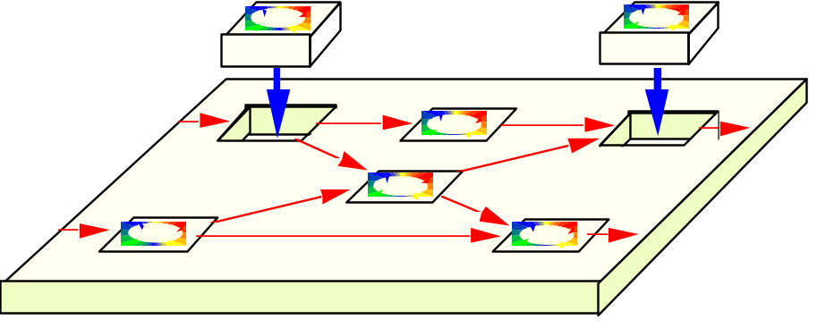
The UP is a Process Framework
There is NO Universal Process!
The Unified Process is designed for flexibility and extensibility
  allows a variety of lifecycle strategies
  selects what artifacts to produce
  defines activities and workers
  models concepts

Slide 99
OO A&D Overview

Slide 100
The purposes of Analysis and Design
To transform the requirements into a design of the system to-be
To evolve a robust architecture for the system
To adapt the design to match the implementation environment, designing it for performance
Notes:
Review the Rational Unified Process Framework and the relationship of the Analysis and Design workflow to the other workflows in the Rational Unified Process Framework.
The Rational Unified Process Framework was introduced in the Introduction to RUP Module.
Highlight what part of the overall process we will be concentrating on (analysis and design activities in an early elaboration iteration).
The purpose of Analysis and Design is to:
Transform the requirements into a design of the system to-be.
Evolve a robust architecture for the system.
Adapt the design to match the implementation environment, designing it for performance.
The Analysis and Design workflow is related to other process workflows.
The Business Modeling workflow provides an organizational context for the system.
The Requirements workflow provides the primary input for Analysis and Design.
The Test workflow tests the system designed during Analysis and Design.
The Environment workflow develops and maintains the supporting artifacts that are used during Analysis and Design.
The Management workflow plans the project and each iteration (described in an Iteration Plan).

Slide 101
Analysis and Design Overview
Design Model
Use-Case Model
Analysis and Design
Architecture
Document
Glossary
Supplementary
Specification
Data Model
Notes:
The input artifacts are the Use-Case Model, Glossary, and Supplementary Specification from the Requirements workflow. The result of analysis and design is a Design Model that serves as an abstraction of the source code; that is, the design model acts as a "blueprint" of how the source code is structured and written. The Design Model consists of design classes structured into design packages; it also contains descriptions of how objects of these design classes collaborate to perform use cases (use-case realizations).
The design activities are centered around the notion of architecture. The production and validation of this architecture is the main focus of early design iterations. Architecture is represented by a number of architectural views. These views capture the major structural design decisions. In essence architectural views are abstractions or simplifications of the entire design, in which important characteristics are made more visible by leaving details aside. The architecture is an important vehicle not only for developing a good design model, but also for increasing the quality of any model built during system development. The architecture is documented in the Architecture Document.
The development of the Architecture Document is out of the scope of this course, but we will discuss it’s contents and how to interpret them.
If a separate analysis model is desired, then an Analysis Model would be listed as a separate artifact (in addition to the Design Model).

Slide 102
Analysis Versus Design
Analysis
  Focus on understanding the problem
  Idealized design
  Behavior
  System structure
  Functional requirements
  A small model
Design
  Focus on understanding the solution
  Operations and Attributes
  Performance
  Close to real code
  Object lifecycles
  Non-functional requirements
  A large model
Notes:
An instructor once said: “Analysis Vs. Design is important because of the mind-set. If you tried to manage all of the analysis and design issues in one go, your brain would explode on all but the most trivial developments. It’s just too much to take in, comprehend, and model in one go. So I mentally switch “OK, analysis - problem domain - don’t care about memory, persistence, databases, language, etc”. “Right now it’s design and I do care about all those things - but now I can stop thinking (too a degree) about trying to understand the business domain.” It’s about managing the 7+/-2 things I can think about in one go. It also separates out the skills (a bit).”
Another instructor once said: “analysis is the study of and eventual comprehension of “some thing” [the problem space]. But to understand it, we must invent some entities to hold onto the thing that we have just grasped - this inventive process is design. That is, human cognitive thinking is actually interwoven analysis/design and any attempt to separate them is really only an idealization. Therefore, if I try to apply two separate “steps” in the production of, say, a class diagram [and call those steps A and then D], I will introduce ambiguity into my process because cognitive process forces one to “produce a solution” in order to “understand a problem” - that D is necessary to have any results from A.”
Think of analysis as an idealized design step - where we ignore several complicating issues. This can turn into a religious debate.
The differences between analysis and design are ones of focus and emphasis. The above slide lists the things that you focus on in analysis versus design.
The goal in Analysis is to understand the problem and to begin to develop a visual model of what you are trying to build, independent of implementation and technology concerns. Analysis focuses on translating the functional requirements into software concepts. The idea is to get a rough cut at the objects that comprise our system, but focusing on behavior (and therefore encapsulation). We then move very quickly, nearly seamlessly into “design” and the other concerns.
A goal of design is to refine the model with the intention of developing a design model that will allow a seamless transition to the coding phase. In design, we adapt to the implementation and the deployment environment. The implementation environment is the 'developer' environment, which is a software superset and a hardware subset of the deployment environment
In modeling, we start with an object model that closely resembles the real world (analysis), and then find more abstract (but more fundamental) solutions to a more generalized problem (design). The real power of software design is that it can create more powerful metaphors for the real world which change the nature of the problem, making it easier to solve.

Slide 103
Analysis and Design is not Top-Down or Bottom-Up
Top
Down
Subsystems
Bottom
Up
Use Cases
Design Classes
Notes:
Analysis and design is not top-down or bottom-up.
The use case comes in from the left and defines a middle level.
The analysis classes are not defined in a top-down pattern or a bottom-up pattern, they are in the middle. From this middle level one may move up or down.
Defining subsystems is moving up and defining design classes is moving down.
Analysis is both top-to-middle, middle-up, middle-down and bottom-to-middle. There is no way of saying that one path is more important than another - you have to travel on all paths to get the system right.
All of these four paths are equally important. That is why the bottom-up and top-down question can´t be solved.

Slide 104
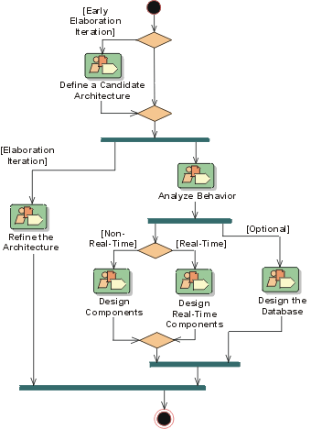
Analysis and Design Workflow
Notes:
A mere enumeration of all workers, activities and artifacts does not constitute a process. We need a way to describe the activities, some valuable result, and interactions between workers. A workflow is a sequence of activities that produces a result of observable value.
In UML terms, a workflow can be expressed as a sequence diagram, a collaboration diagram, or an activity diagram. We use a form of activity diagram in the Rational Unified Process. For each core workflow, an activity diagram is presented. This diagram shows the workflow, expressed in terms of workflow details.
This slide shows the Analysis and Design workflow. The early Elaboration Phase focuses on creating an initial architecture for the system (Define a Candidate Architecture) to provide a starting point for the main analysis work. If the architecture already exists (either because it was produced in previous iterations, in previous projects, or is obtained from an application framework), the focus of the work changes to refining the architecture (Refine the Architecture) and analyzing behavior and creating an initial set of elements which provide the appropriate behavior (Analyze Behavior).
After the initial elements are identified, they are further refined. Design Components and Design Real-Time Components produce a set of components which provide the appropriate behavior to satisfy the requirements on the system. In parallel with these activities, persistence issues are handled in Design the Database. The result is an initial set of components which are further refined in the Implementation Workflow.
Each workflow contains RUP activities that can take place. RUP activities can exist in many different workflow activities. For example, Use-Case Analysis can be found in both Define a Candidate Architecture and Analyze Behavior.

Slide 105
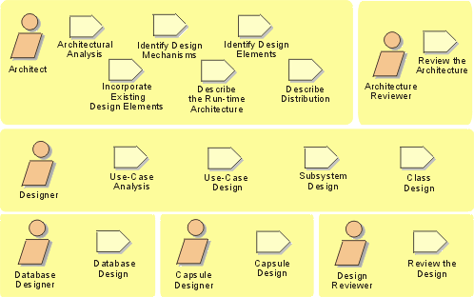
Analysis and Design Activity Overview
Notes:
Remember, for analysis and design, we start out with the use-case model and the supplementary specifications from the Requirements workflow and end up with the design model that serves as an abstraction of the source code.
The design activities are centered around the notion of architecture. The production and validation of this architecture is the main focus of early design iterations. The architecture is an important vehicle not only for developing a good design model, but also for increasing the quality of any model built during system development.
The focus of this course is on the activities of the Designer. The Architect’s activities will be discussed, but many of the architectural decisions will be “given”. Each of the Architect and Designer activities will be addressed in individual course modules.
Walk the students through the activities reviewing the meaning of the representational icons (e.g., workers, activities). Activities can be considered operations on the workers.
The order shown is not the order in which the activities can be executed. The analysis and design workflow helps to dictate order.
The process as described in this course develops a design model, not a separate analysis model. To maintain a separate analysis model, some modifications to the process would be necessary, the discussion of which is out of the scope of this course.
Emphasize the Use-Case Analysis activity and how it describes a process for finding classes and objects from use cases. Some people have called it: 'closing the traceability gap’ -- use cases and scenario's help you get from requirements to objects.

Slide 106
Workers and Their Responsibilities
Use-Case
Realization
Architect
Designer
Package/
Subsystem
Design Model
Class
Software Architecture
Document
Design
Reviewer
Data Model
Database Designer
Architecture
Reviewer
Notes:
Again, the focus of this course is on the activities and artifacts of the Designer.
The Architect leads and coordinates technical activities and artifacts throughout the project. The Architect establishes the overall structure for each architectural view: the decomposition of the view, the grouping of elements, and the interfaces between these major groupings. Thus, in contrast with the other workers, the Architect's view is one of breadth, as opposed to depth.
A Designer defines the responsibilities, operations, attributes, and relationships of one or several classes and determines how they should be adjusted to the implementation environment. A Designer may have responsibility for one or more Design Packages or Design Subsystems, including any classes owned by the packages or subsystems. A Designer may be responsible for a Use-Case Realization, in order to ensure the overall consistency of how a particular use case is realized using the design elements.
The Database Designer defines the tables, indexes, views, constraints, triggers, stored procedures, table spaces or storage parameters, and other database-specific constructs needed to store, retrieve, and delete persistent objects. This information is maintained in the Data Model.
The Architecture Reviewer plans and conducts the formal reviews of the software architecture in general.
The Design Reviewer plans and conducts the formal reviews of the design model.

Slide 107
1.4 Component and CBSD
Component
CBSD

Slide 108
Component
Definition of a (Software) Component
  A non-trivial, nearly independent, and replaceable part of a system that fulfills a clear function in the context of a well-defined architecture.
  A component conforms to and provides the physical realization of a set of interfaces.
  A physical, replaceable part of a system that packages implementation and conforms to and provides the realization of a set of interfaces.
  A component represents a physical piece of implementation of a system, including software code (source, binary or executable) or equivalents such as scripts or command files.
Notes:
Architecture is a part of design. Architecture is about making decisions on how the system will be built. But it is not all of the design. It stops at the major abstractions, the major elements; in other words, the elements that have some pervasive and long-lasting effect on the qualities of the system, namely its ability to evolve, its performance.
A software system’s architecture is perhaps the most important aspect that can be used to control the iterative and incremental development of a system throughout its lifecycle.
The most import property of an architecture is resilience -- flexibility in the face of change. To achieve it, architects must anticipate evolution in both the problem domain and implementation technologies to produce a design that can gracefully accommodate such changes. Key techniques are abstraction, encapsulation, and object-oriented analysis and design. The result is applications are fundamentally more maintainable and extensible.
You can encourage discussion at this point. A single requirement, such as throughput or fault tolerance, affects almost every design decision made on a system. For example, if building a transportation system (such as for trains), it is likely that they will have a “no single point of failure” requirement that must be in every developer’s mind every step of the way. Many architectural mechanisms will be developed to accommodate that single requirement. If you can get some students to describe their architectural challenges, this point is more effectively driven home.

Slide 109
CBSD - Component-Based Software Development
Resilient
  Meets current and future requirements
  Improves extensibility
  Enables reuse
  Encapsulates system dependencies
Component-based
  Reuse or customize components
  Select from commercially-available components
  Evolve existing software incrementally
Notes:
Architecture is a part of design. Architecture is about making decisions on how the system will be built. But it is not all of the design. It stops at the major abstractions, the major elements; in other words, the elements that have some pervasive and long-lasting effect on the qualities of the system, namely its ability to evolve, its performance.
A software system’s architecture is perhaps the most important aspect that can be used to control the iterative and incremental development of a system throughout its lifecycle.
The most import property of an architecture is resilience -- flexibility in the face of change. To achieve it, architects must anticipate evolution in both the problem domain and implementation technologies to produce a design that can gracefully accommodate such changes. Key techniques are abstraction, encapsulation, and object-oriented analysis and design. The result is applications are fundamentally more maintainable and extensible.
You can encourage discussion at this point. A single requirement, such as throughput or fault tolerance, affects almost every design decision made on a system. For example, if building a transportation system (such as for trains), it is likely that they will have a “no single point of failure” requirement that must be in every developer’s mind every step of the way. Many architectural mechanisms will be developed to accommodate that single requirement. If you can get some students to describe their architectural challenges, this point is more effectively driven home.

Slide 110

Purpose of a CBSD
Basis for reuse
  Component reuse
  Architecture reuse
Basis for project management
  Planning
  Staffing
  Delivery
Intellectual control
  Manage complexity
  Maintain integrity
Component-based Architecture with
layers
Application-
specific
Business-
specific
Middleware
System-
software
Notes:
Definition of a (Software) Component:
A non-trivial, nearly independent, and replaceable part of a system that fulfills a clear function in the context of a well-defined architecture. A component conforms to and provides the physical realization of a set of interfaces.
A physical, replaceable part of a system that packages implementation and conforms to and provides the realization of a set of interfaces. A component represents a physical piece of implementation of a system, including software code (source, binary or executable) or equivalents such as scripts or command files.
Because students vary in how familiar they are with the concept of architecture applied to software, it is best to get a sense of this from the students before beginning this section. If they are fairly unfamiliar, it helps to use the analogy to buildings or civil engineering. The more complex the building, the more critical a good architecture is. The longer you want the building to be useful, the more effort and expense you will put into the architecture. And in both of these cases, the choice of architect is critical.

Slide 111
1.5 Patterns and Architecture
Basic Concepts of Patterns
Basic Concepts of Software Architecture

Slide 112
Basic Concepts of Patterns

Slide 113
Basic Concepts of Patterns
What is a pattern?
Part of a pattern
Some example patterns
Modeling a pattern with UML

Slide 114
What is a pattern?
What is a pattern?
• A common problem
– and a proven solution
– in a context
• A structured, packaged problem solution in literary form.
• A way of recording experience, “best practices”
– In a standard format
– A repository for knowledge
• “What’s new is that there’s nothing new here.
Patterns are about what works. Patterns give us a way to talk about what works.” – Brian Foote, 1997.

Slide 115
Parts of a Pattern
• Name:
a good name is essential because pattern names help designers to communicate.
• Context:
where the pattern can be applied
• Forces:
to be balanced in the solution
• Problem:
usually describes in terms of the forces.
• Solution:
a proven way of balancing the forces

Slide 116
Some Example Patterns
Alexander pattern: Window place
Architectural pattern: MVC
Design pattern: Observer
Analysis pattern: Party

Slide 117
An Alexander Pattern - Window Place
• Name: Window Place
• Context and forces:
a room has a window and a place to sit
– We are drawn towards the light
– We want to sit comfortably
• Problem:
how to be comfortable and still near the natural light
• Solution:
place the comfortable sitting place near the
window (e.g., a window seat)

Slide 118
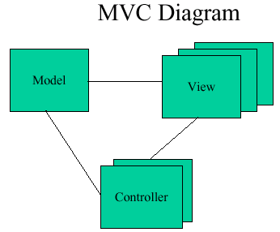
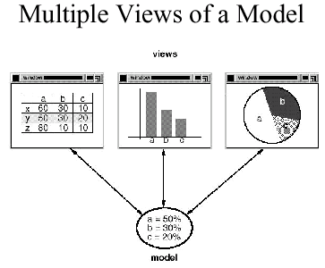
Architectural Pattern - MVC
• Name: MVC (Model-View-Controller)
• Context and forces: we have a data model and several representations of the data
– We want to modularize the system
– Data representation must be kept up to date
• Problem: how to modularize the system
• Solution: the model holds the data (and does data modification), the view represents the data, the controller handles user input

Slide 119
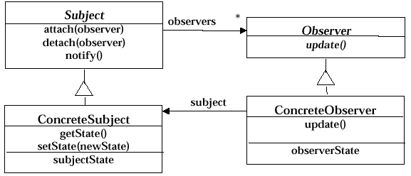
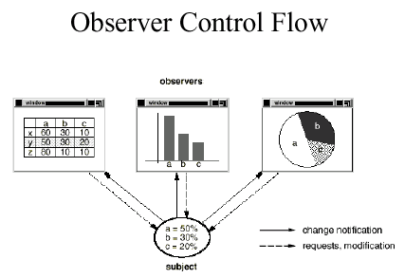
Design Patterns - Observer
• Name: Observer
• Context and forces: data is kept in one object and displayed in other objects
– We want to distribute the functions
– We want the system to stay consistent
• Problem: keep the information consistent
• Solution: the display objects observe the object holding the data and are notified of changes in the data

Slide 120
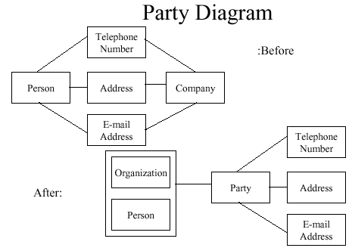
Analysis Pattern - Party
• Name: Party
• Context and forces:
we have people and organizations that both take on roles in the system
– We want to allow several types of entities
– We want to treat all entities consistently
• Problem: how can we treat them uniformly without complicating the diagrams?
• Solution: Add a party entity which unifies the two entities

Slide 121
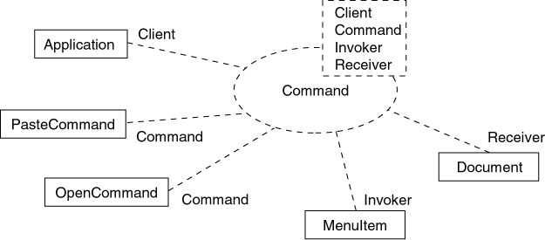
Modeling a pattern with UML

Slide 122
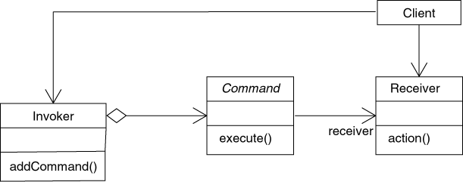
Modeling a pattern with UML

Slide 123
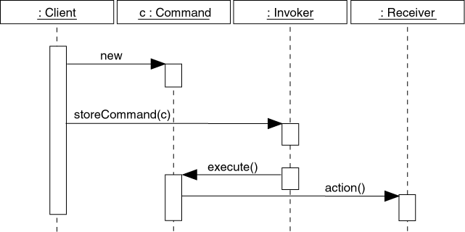
Modeling a pattern with UML

Slide 124
Basic Concepts of Software
Architecture

Slide 125
What Is Architecture?
Software architecture encompasses the set of significant decisions about the organization of a software system
  Selection of the structural elements and their interfaces by which a system is composed
  Behavior as specified in collaborations among those elements
  Composition of these structural and behavioral elements into larger subsystems
  Architectural style that guides this organization
Grady Booch, Philippe Kruchten, Rich Reitman, Kurt Bittner; Rational
(derived from Mary Shaw)
Notes:
Based on extensive research, Rational has established a definition of architecture.
“Significant” in this context implies strategic, of major impact.
The architecture has a static and a dynamic perspective.
The architecture for similar systems should be similar (a particular style is used).
An equation we have used is:
Architecture = Elements + Form + Rationale.
Rationale is essential for justifying a good architecture.
Patterns are the guidelines for assembling elements in some form. We will discuss patterns in the architecture modules.
Emphasize that the rationale for the architectural decisions is very important. Remember that RUP is use-case driven AND architecture-centric. Therefore, the architecture is going to drive design activities.

Slide 126
What is Software Architecture ?
Software architecture also involves
  usage
  functionality
  performance
  resilience
  reuse
  Comprehensibility
  economic and technology constraints and tradeoffs
  aesthetic concerns

Slide 127
Architecture Constrains Design and Implementation
Architecture involves a set of strategic design decisions, rules or patterns that constrain design and construction
architecture
design
implementation
CODE
Architecture decisions are the most fundamental decisions and changing them will have significant ripple effects.
Notes:
Architectures can be viewed as a set of key design decisions.
The architecture is the initial set of constraints placed on the system. Such constraints are the the most important constraints. They constitute the fundamental decisions about the software design. Architecture puts a framework around the design. Architecture has been called strategic design.
An architect’s job is to eliminate unnecessary creativity. As you move closer to code, creativity is eliminated (the architecture constrains the design which constrains the implementation). This is good because during implementation, the creativity can be spent elsewhere (e.g., for improving the quality, performance, etc.) of the implementation (e.g., code).
If architecture is strategic design, then the rest of the design is the tactical design.

Slide 128
The common theme in all software architecture definitions
Regardless of the definition (and there are many) the common theme in all software architecture definitions is that it has to do with the large scale —
  the Big Ideas in the forces,
  organization,
  styles,
  patterns, responsibilities,
  collaborations,
  connections,
  and motivations of a system (or a system of systems),
  and major subsystems.

Slide 129
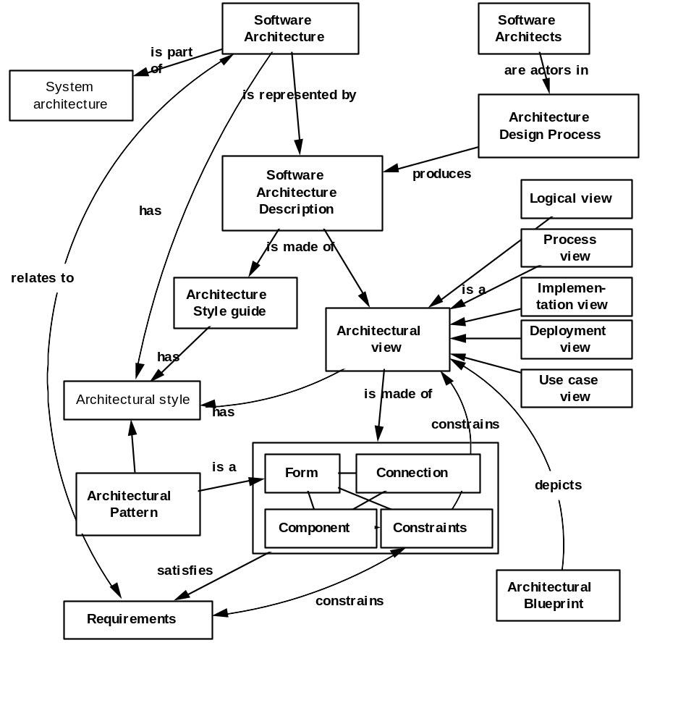
Architecture metamodel (Booch)

Slide 130
Architectural view
An architectural view is a simplified description (an abstraction) of a system from a particular perspective or vantage point, covering particular concerns, and omitting entities that are not relevant to this perspective

Slide 131
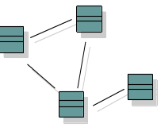

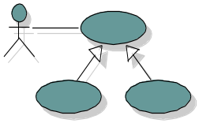
Software Architecture: The “4+1 View” Model
Logical View
Implementation View
Analysts/Designers
Structure
End-user
Programmers
Software management
Functionality
Use-Case View
Process View
Deployment View
System integrators
System engineering
Performance
Scalability
Throughput
System topology
Delivery, installation
communication
Notes:
Discuss the 4+1 views. These are covered in detail in the Rational Unified Process.
The 4+1 model is introduced here and because it is important for the students to see how the views fit together up front, in order to set context. The individual views are addressed in the specific architecture modules:
The Logical view will be discussed in the Architectural Analysis and Identify Design Elements module.
The Process View will be discussed in the Describe Concurrency module.
The Deployment View will be discussed in the Describe Distribution module.
The Implementation View will be discussed briefly in the Identify Design Elements module; however, the Implementation View is developed during Implementation and is thus considered out of scope for this analysis and design course.
The above diagram shows the model Rational uses to describe the software architecture.
Architecture is many things to many different interested parties. On a particular project, there are usually multiple stakeholders, each with their own concerns and view of the system to be developed. The goal is to provide each of these stakeholders with a view of the system that addresses their concerns, and suppresses the other details.
To address these different needs, Rational has defined the “4+1 view” architecture model. An architectural view is a simplified description (an abstraction) of a system from a particular perspective or vantage point, covering particular concerns, and omitting entities that are not relevant to this perspective. Views are “slices” of models.
Not all systems require all views (e.g., single processor: drop deployment view; single process: drop process view; small program: drop implementation view, etc.). A project may document all of these views or additional views. The number of views is dependent on the system you’re building.
Each of these views, and the UML notation used to represent them, will be discussed in subsequent modules.

Slide 132
How many views?
Simplified models to fit the context
Not all systems require all views:
  Single processor: drop deployment view
  Single process: drop process view
  Very Small program: drop implementation view
Adding views:
  Data view, security view

Slide 133
Architectural Style
Non software examples
  http://www.bc.edu/bc_org/avp/cas/fnart/fa267/amstyles.html
An architecture style defines a family of systems in terms of a pattern of structural organization.
An architectural style defines
  a vocabulary of components and connector types
  a set of constraints on how they can be combined
  one or more semantic models that specify how a system’s overall properties can be determined from the properties of its parts

Slide 134
Architecturally significant elements
Not all design is architecture
Main “business” classes
Important mechanisms
Processors and processes
Layers and subsystems
Architectural views = slices through models

Slide 135
Architectural Focus
Although the views above could represent the whole design of a system, the architecture concerns itself only with some specific aspects:
The structure of the model - the organizational patterns, for example, layering.
The essential elements - critical use cases, main classes, common mechanisms, and so on, as opposed to all the elements present in the model.
A few key scenarios showing the main control flows throughout the system.
The services, to capture modularity, optional features, product-line aspects.

Slide 136
Characteristics of a Good Architecture
Resilient
Simple
Approachable
Clear separation of concerns
Balanced distribution of responsibilities
Balances economic and technology constraints

